Slide 1
Spent Wash Evaporation
with
MVR Based Plate Type Evaporator
A Saad Masud Presentation At PSST Annual Convention
September 12, 2023
Sustainable Environment Developers
Formerly known as Spray Engineering Devices

Slide 2
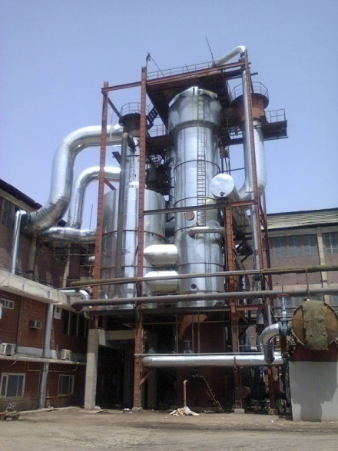
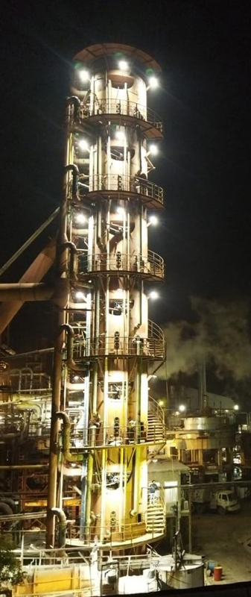
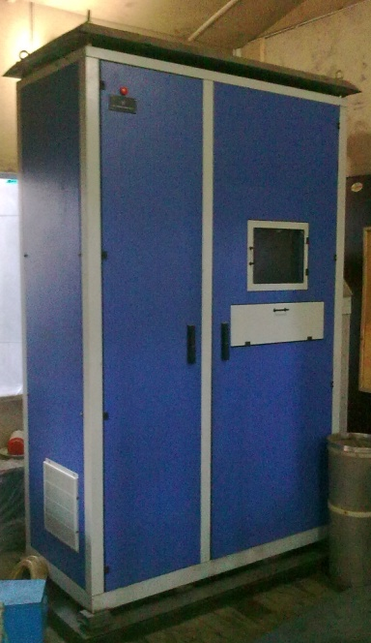
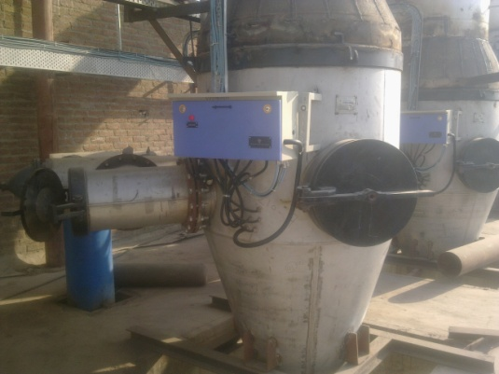
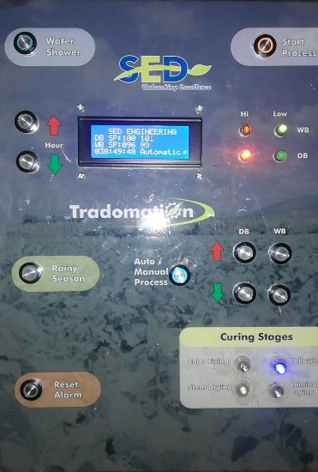
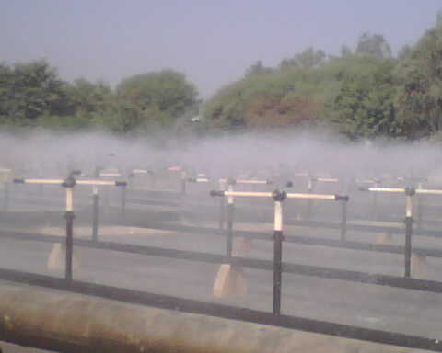
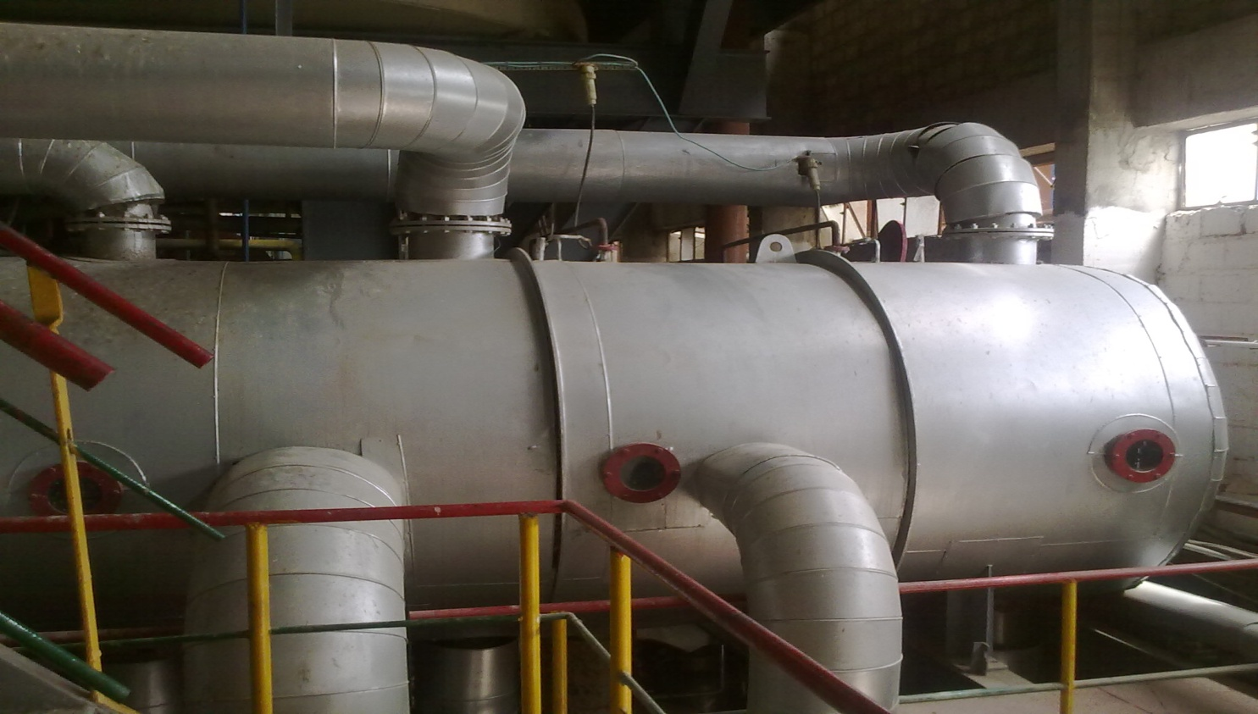
Product Overview

Slide 3
The Problem
Disposal of Spent Wash with required COD level is a challenge faced by all Molasses based Distilleries.
High COD level water is a threat to the environment.
The local plant operators are searching for the optimum solution with minimum operating cost.
Keeping in view the above problem SED came up with the following solution which is already in operation.

Slide 4
The Solution
MVR Based Plate Type Evaporator

Slide 5
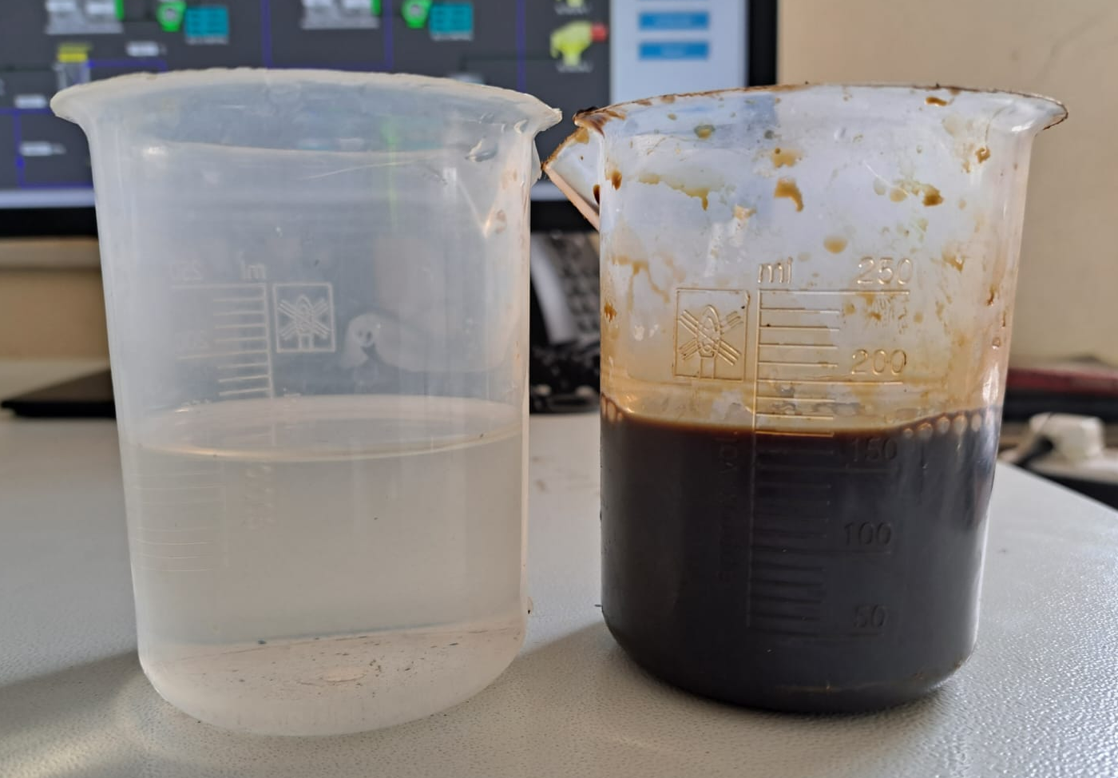
Case Study
Raw Material: Molasses
Capacity: 40,000 Liters/day
Location: Kisumu, Kenya
Operating Days: 365
Other Units in the Complex:
Kibos Sugar Limited - 4500 TCD
Kibos Paper Products – 200 Tons/Day
Kibos Fertilizer

Slide 6
Process Flow Chart
SPENT WASH
150m³
80-85m³/day
CONDENSATE
KIBOS PAPER
MVR Evaporator
Condensate Quantity:
80-85m³/day
TDS : 150
COD: 2,000 ppm.
Input Brix: 24
Input COD: 250,000ppm
Input TDS: 240,000
CONDENSATE
POLISHING
UNIT
Quantity: 80-85m³/day
TDS : 500
COD: 20 ppm
Steam Turbine
100Kw/Hr.
50 Tons.
REJECT
KIBOS FERTILIZER

Slide 7
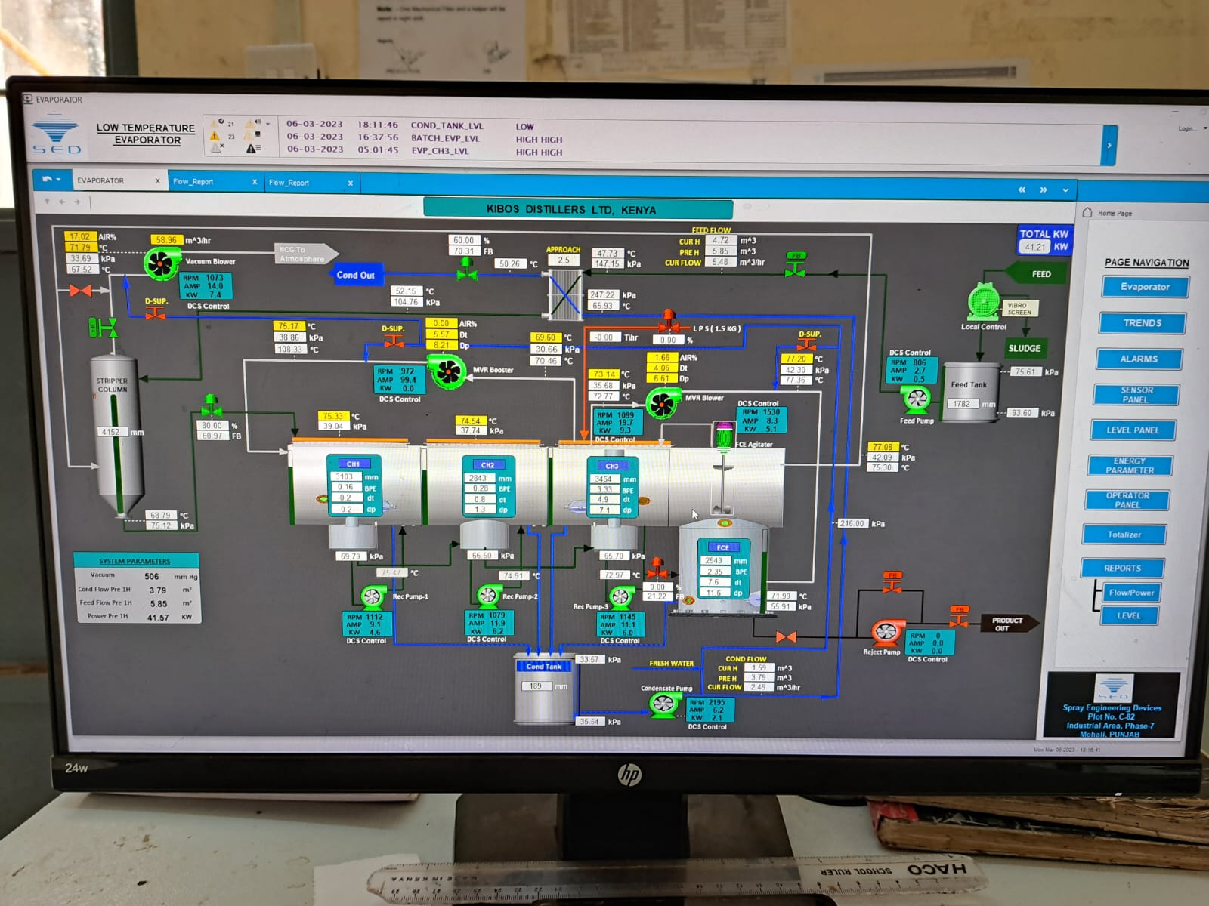
Spent Wash Evaporator

Slide 8
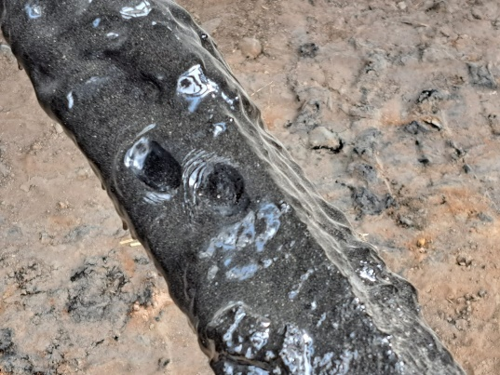
Spent Wash Evaporator
Capacity- 120m³/Day
Operating at 150m3/day
Input Qty : 150m³/day
Input Brix: 24
Input COD: 250,000ppm
Input TDS: 240,000
Power Load 100kw/hr
Condensate Parameters
Quantity: 80-85m³/day
TDS : 150
COD: 2,000 ppm.
Clear water as condensate.
Reject Parameters:
Quantity: 66m³(50 Ton)
Brix: 55
COD: 800,000ppm
TDS: 550,000

Slide 9
Spent Wash Evaporator
Solution side
Vapour flow path
Looking into the tube side flow direction

Slide 10
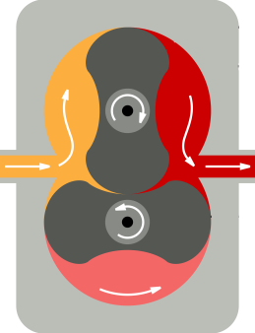
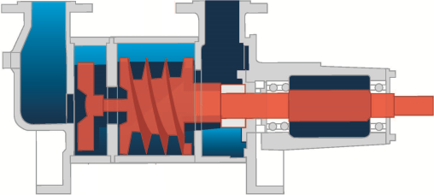
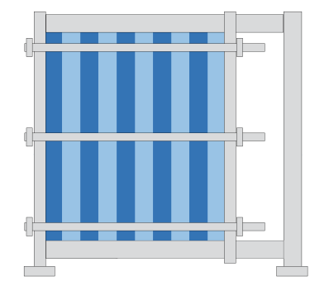
Vapor Out
MVR Based Evaporator
MVR
Compressed Vapour In
Vapor Out
Clean Water Out
Wastewater In
Compressed Vapour In
Feed Out
Vacuum Pump
NCG
Heating Medium
Feed Out
PHE
MVR
Clean Water Out
Vacuum Pump
PHE
Wastewater In

Slide 11
Comparison with Pakistan
Spent Wash Parameters | KIBOS Kenya | Pakistan
Input Brix | 24 | 8
Input COD | 250,000 ppm | 30,000 ppm
Input TDS | 240,000 | 80,000
 | Spent Wash Comes Directly from Distillery | Spent Wash come after Bio Methanation
Input Quantity | 400 m³ | 1200 m³

Slide 12
Proposed Flow Diagram
Distillery Spent Wash
Condensate Polishing Unit
CPU
1200m³/day
Condensate
Quantity: 850m³/day
TDS : 75
COD: 200 ppm.
Foam Removal
Quantity: 650m³/day
TDS : 200
COD: 20 ppm.
MVR
Evaporator
Distillery/ Utilities
Reject
Quantity: 300Tons
Brix: 55
100 Tons/day
1.2 Mw/hr
Dryer
Steam Turbine
Bio Fertilizer/day
Steam & Power for Drying

Slide 13
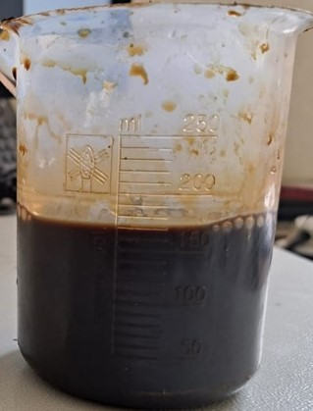
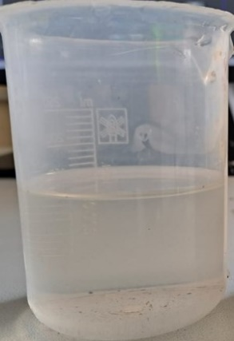
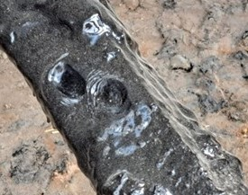
Inputs and Outputs
A simple estimate … if you have 100m³ of Spent wash
Spent Wash Quantity | 100 m³ / Day
Condensate Water | 55 m³ / Day
Reject | 45 m³ or 34 Tons / day at 55 Brix
Dry Output | 08 Tons / day
INPUT
OUTPUT
Spent Wash
Condensate
Reject
+

Slide 14
Objectives…WE can Achieve
Zero Liquid Discharge (ZLD)
Reduced requirement of Fresh Water
Better Crop Quality through organic Fertilizer
Significant Revenues from Sale of Bio Fertilizer
Better relations with Environment Agencies

Slide 15
Let’s Protect the Environment TOGETHER
Sustainable Environment Developers
Head Office: B-144, Block 11, Gulistan-e-Jauhar, Karachi.  +92-21-34184313  contact@sedl.pk
Factory: C-66, Phase I, S.I.T.E –II, Superhighway, Karachi.  : +92-300-0342650  www.sedl.pk

